Slide 2
Minor Project- 1
on
Comparative Analysis of shortest path algorithms
Under the Guidance of:
Dr. Deepak Sharma
(Head of Computer Science)
Presented by:
Siddhi Gupta
R100218061
500067967
Yogesh
R100218069
500069549
Tushar Goyal
R100218072
500068373
Bhavuk Baluja
R100218073
500070089

Slide 3
Abstract
Shortest Path Algorithm states that the algorithm to find the path which has minimal Distance(or path) between two nodes (or vertices).
Some examples of Shortest Path are: telecommunications, network routing protocols, traffic control, transportation systems, etc.
The algorithms used to find the shortest path are Dijkstra’s, Bellman-Ford and Floyd-Warshall Algorithm.
Comparing, analyzing and plotting the graphs of each algorithm makes it easy to understand which algorithm is best for finding the shortest path for a particular type of question.

Slide 4
Problem Statement
There are several projects for finding the shortest path but they all give the output in written form, which is difficult to understand and it takes more time to understand the shortest path.
Therefore, there is a need for a project which compares all the algorithms on the basis of their time complexity and gives the output in written form as well as in graphical form step by step which makes it easy to understand the shortest path.

Slide 5
Objectives
The main objective of this project is to compare all the algorithms by plotting their graphs on the basis of their time complexity and give the output in written form as well as in graphical form step by step which makes it easy to understand the shortest path and tells which algorithm should be used to solve the question more efficiently for a particular type of question.

Slide 6
Methodology
Preparing the data flow diagram of the project.
Implementation, Comparison and Analyzing of different Algorithms by plotting the graphs on the basis of their time complexity and unit testing.
Integrating the modules.
Testing the integration of modules.
Testing the system.

Slide 7
Pseudocode
Bellman Ford Algorithm:-
function bellmanFord(G, S)
for each vertex V in G
distance[V] <- infinite
previous[V] <- NULL
distance[S] <- 0
for each vertex V in G
for each edge (U,V) in G
tempDistance <- distance[U] + edge_weight(U, V)
if tempDistance < distance[V]
distance[V] <- tempDistance
previous[V] <- U
for each edge (U,V) in G
If distance[U] + edge_weight(U, V) < distance[V]
Error: Negative Cycle Exists
return distance[], previous[]

Slide 8
Pseudocode
Dijkstra’s Algorithm:-
function dijkstra(G, S)
for each vertex V in G
distance[V] <- infinite
previous[V] <- NULL
If V != S, add V to Priority Queue Q
distance[S] <- 0
while Q IS NOT EMPTY
U <- Extract MIN from Q
for each unvisited neighbour V of U
tempDistance <- distance[U] + edge_weight(U, V)
if tempDistance < distance[V]
distance[V] <- tempDistance
previous[V] <- U
return distance[], previous[]

Slide 9
Pseudocode
Floyd-Warshall Algorithm:-
n = no of vertices
A = matrix of dimension n*n
for i = 1 to n
for j = 1 to n
if there is an edge from i to j
dist[i][j] = the length of the edge from i to j
for k = 1 to n
for i = 1 to n
for j = 1 to n
A^{k}[i, j] = min (A^{k-1}[i, j], A^{k-1}[i, k] + A^{k-1}[k, j])
return A

Slide 10
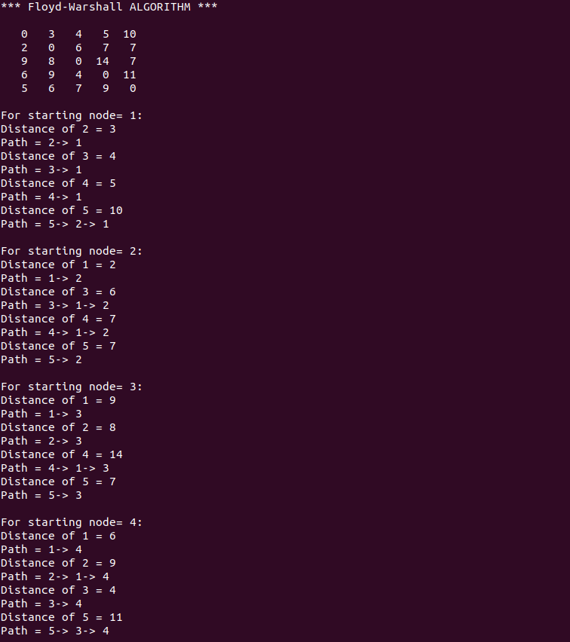
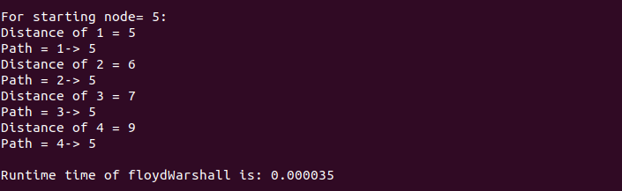
Output/ Result
Floyd-Warshall Algorithm (written form)

Slide 11
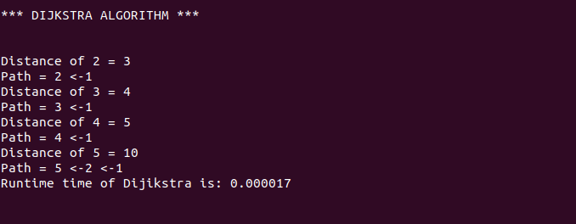
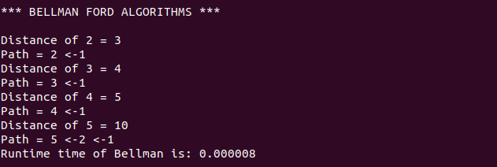
Dijkastra’s Algorithm (written form)
Bellman Ford Algorithm (written form)

Slide 12
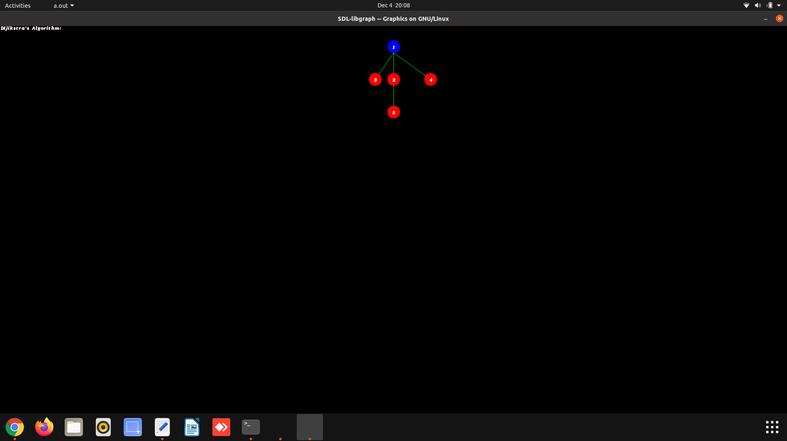
Dijkstra’s Algorithm (Graphical Representation)
NOTE: Every nodes comes step by step.

Slide 13

Bellman Ford Algorithm (Graphical Representation)
NOTE: Every nodes comes step by step.

Slide 14

Floyd-Warshall Algorithm (Graphical Representation)
NOTE: Every nodes comes step by step.

Slide 15
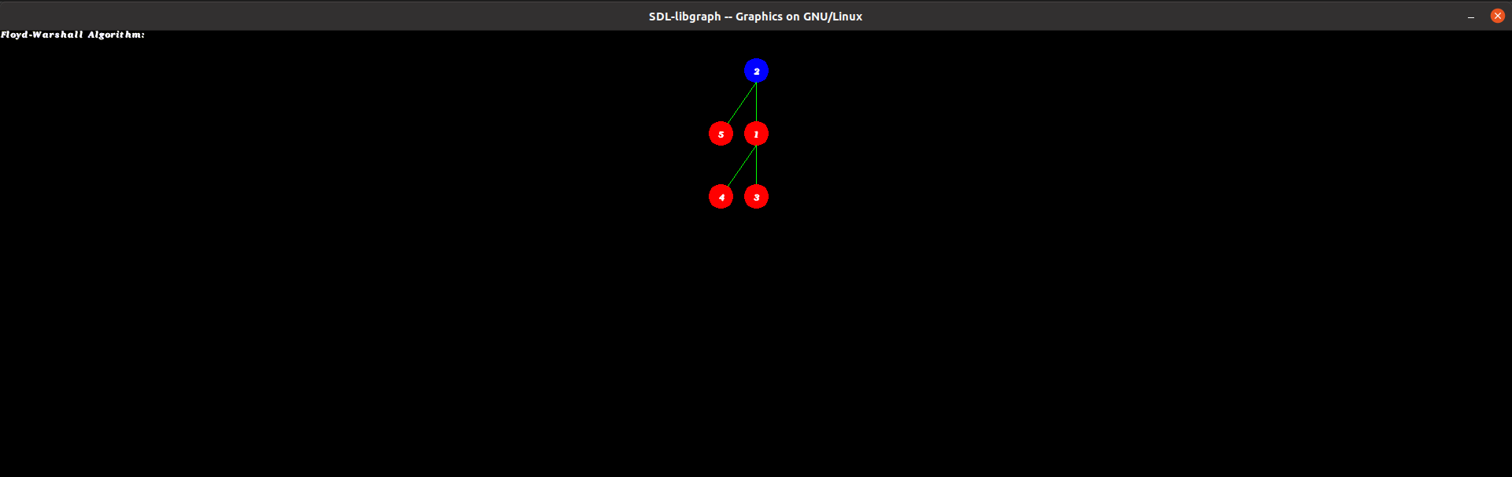
Floyd-Warshall Algorithm (Graphical Representation)
NOTE: Every nodes comes step by step.

Slide 16

Floyd-Warshall Algorithm (Graphical Representation)
NOTE: Every nodes comes step by step.

Slide 17

Floyd-Warshall Algorithm (Graphical Representation)
NOTE: Every nodes comes step by step.

Slide 18
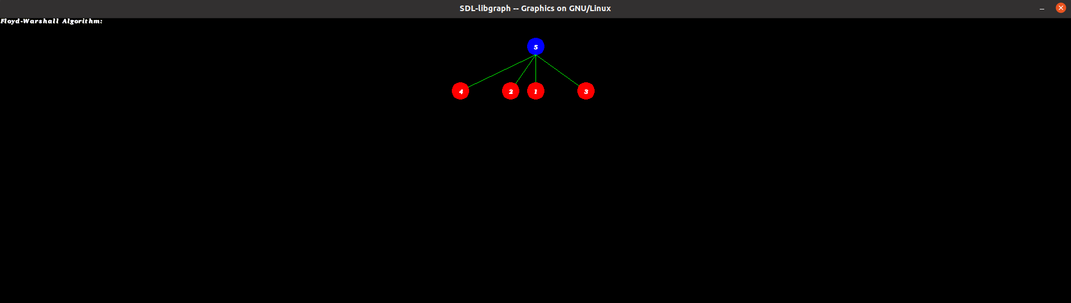
Floyd-Warshall Algorithm (Graphical Representation)
NOTE: Every nodes comes step by step.

Slide 19
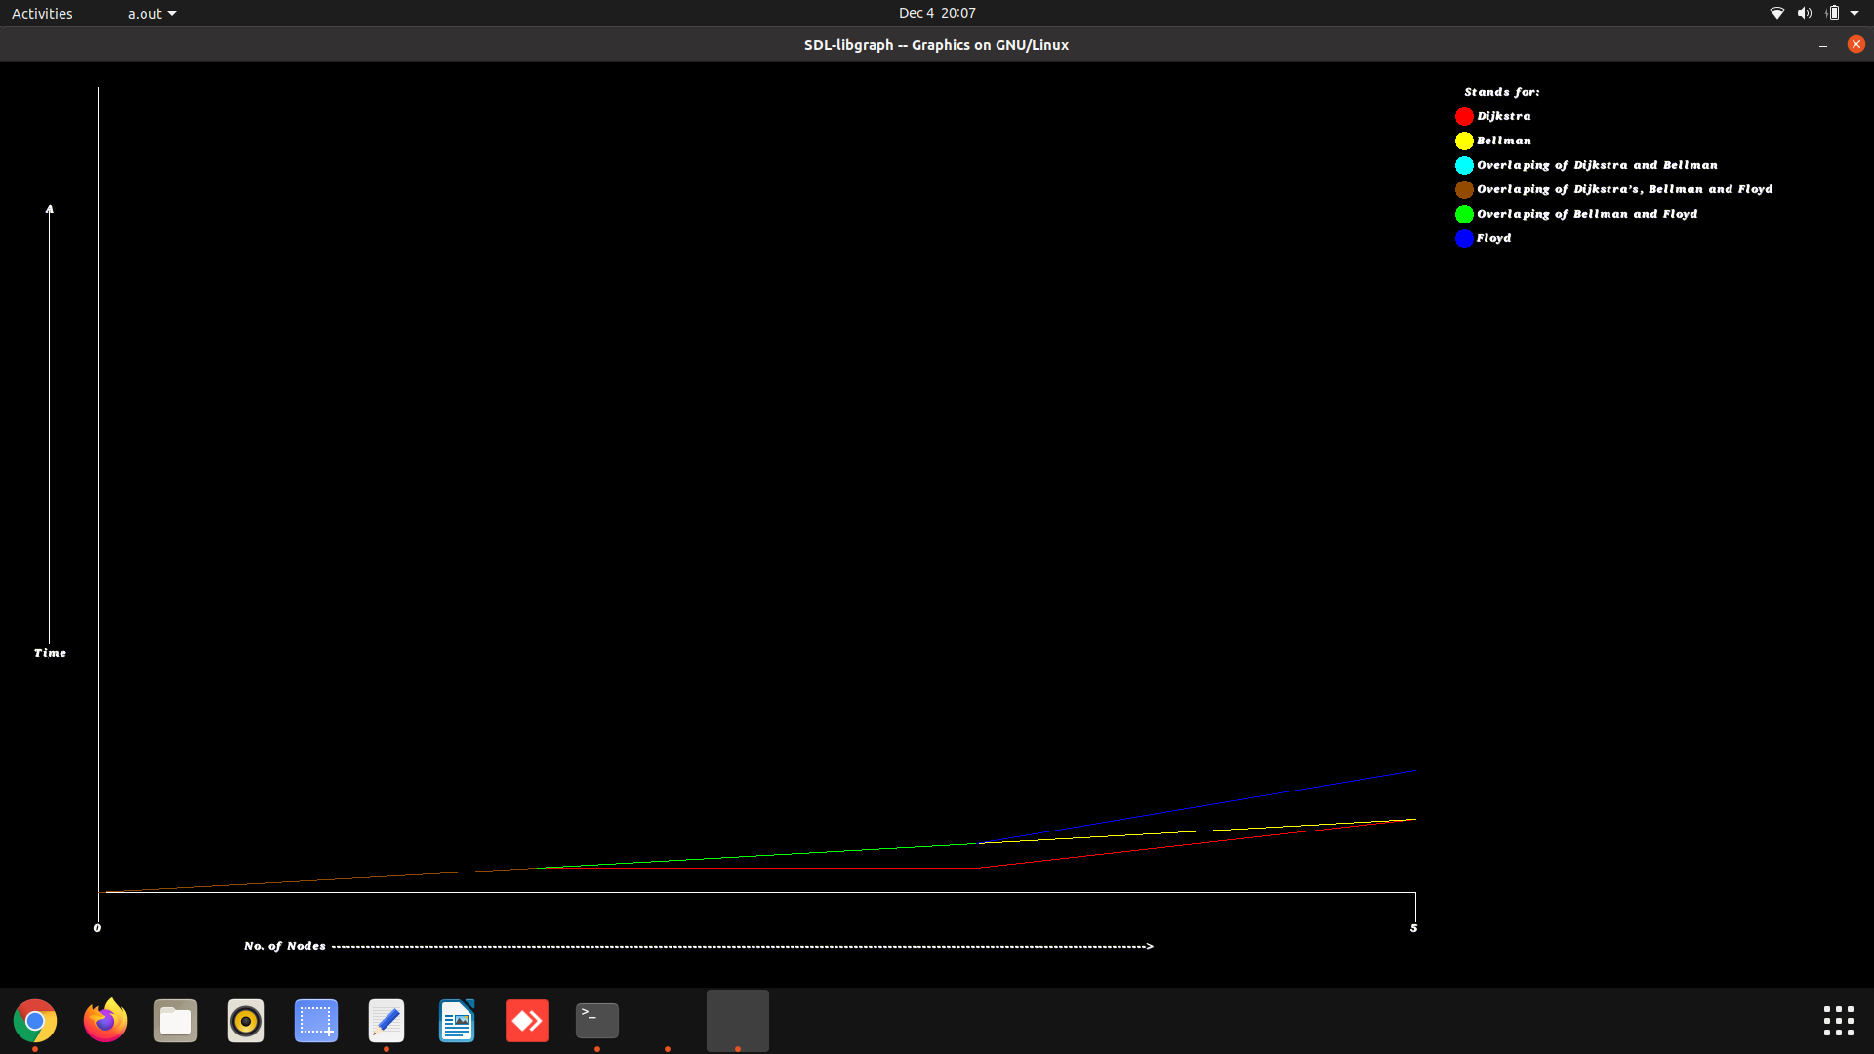
Time Complexity Graph

Slide 20
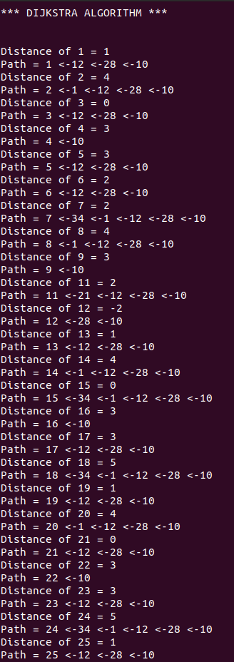
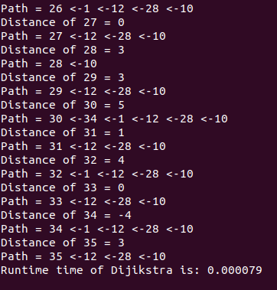
Negative Cycle
Dijkstra’s Algorithm (written form)

Slide 21
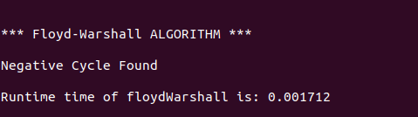
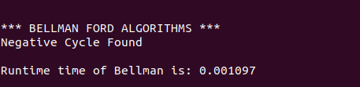
Negative Cycle
Floyd-Warshall Algorithm (written Form)
Bellman Ford Algorithm (written form)

Slide 22
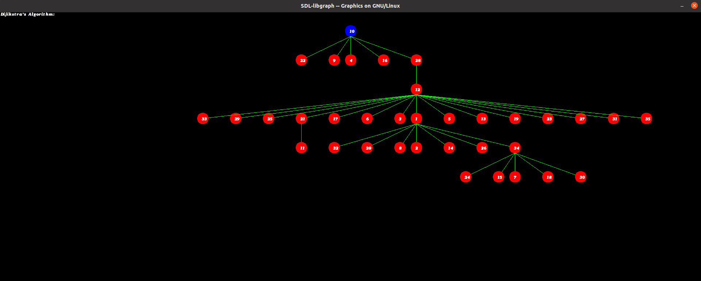
Dijkstra’s Algorithm (Graphical Representation)
NOTE: Every nodes comes step by step.

Slide 23
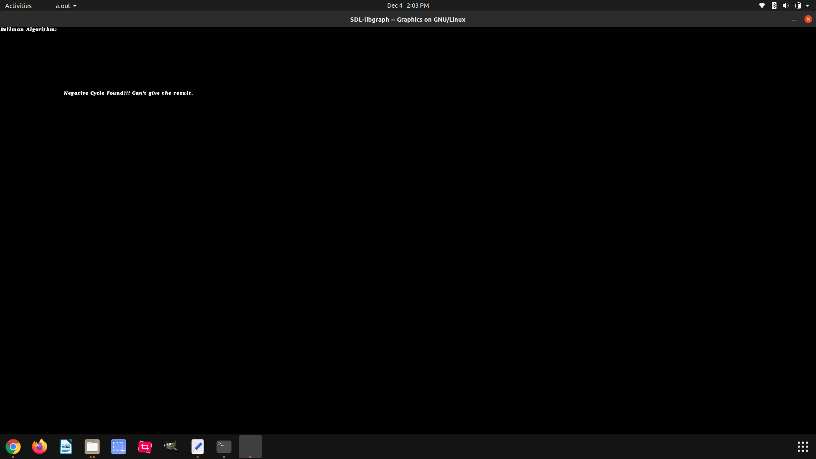
Bellman Ford Algorithm (Graphical Representation)
NOTE: Every nodes comes step by step.

Slide 24
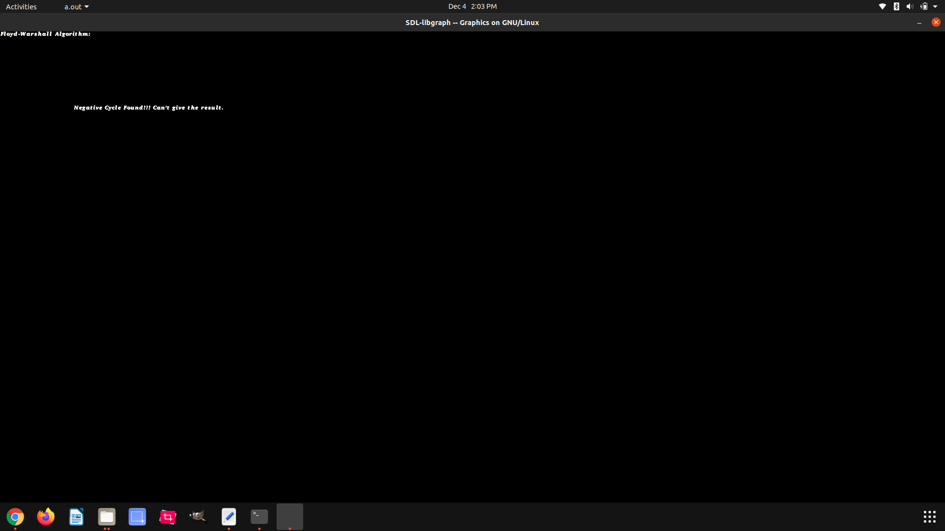
Floyd-Warshall Algorithm (Graphical Representation)
NOTE: Every nodes comes step by step.

Slide 25
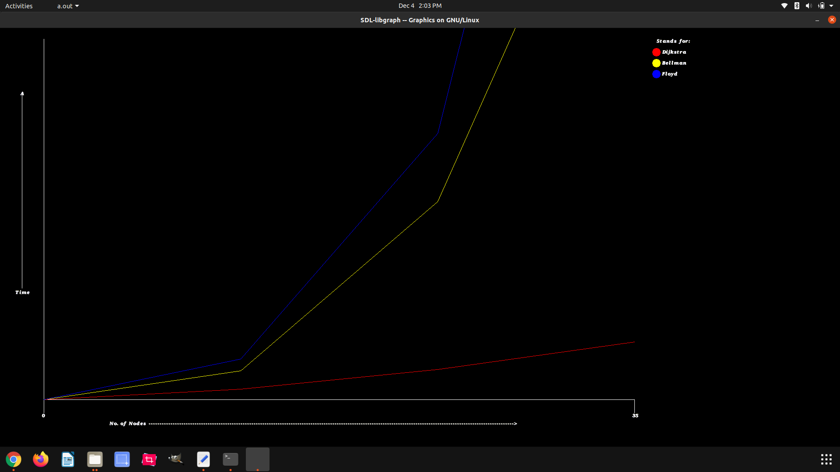
Time Complexity Graph

Slide 26
Scope of Project
Least-cost paths are calculated for instance to establish tracks of electricity lines and oil pipelines.
Network Routing Protocol.
Road Networks.

Slide 27
Conclusion
By plotting the graphs of all 3 Algorithms on the basis of their time complexities it is easy to compare the algorithms. All of the 3 Algorithms provides a solution with having some time complexities. The time complexity for each of the 3 Algorithms are on the basis of their efficiency to solve the shortest path problem.
For more convenience it gives the output in written form as well as in graphical form step by step which makes it easy to understand the shortest path.

Slide 28
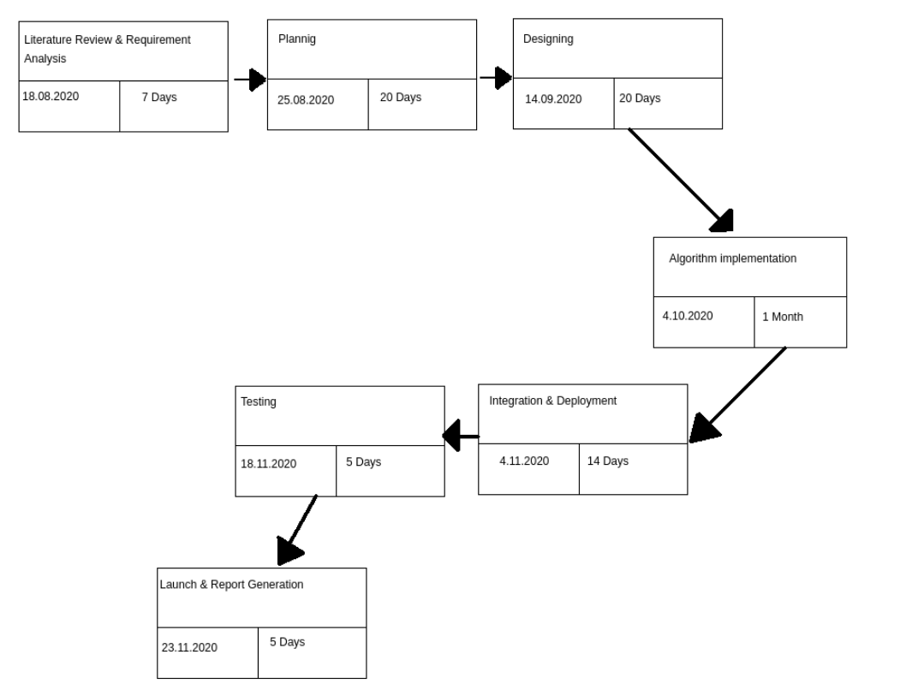
PERT Chart

